Slide 1
Introduction to Python in AI
Md. Monarul Islam Mithu
Lecturer, Dept. Of CSE, DIU

Slide 2
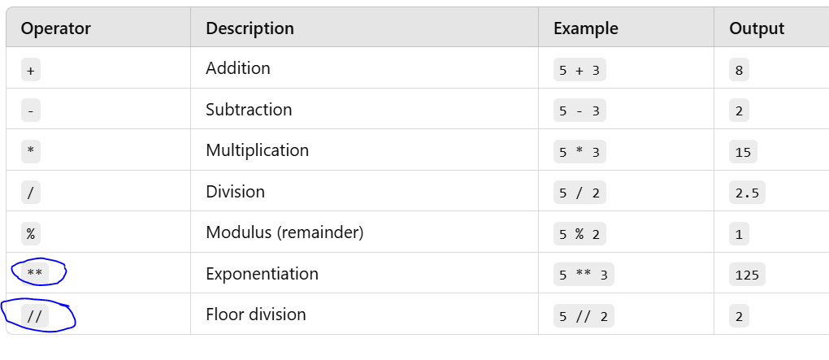
Recall: Operators in Python [Arithmetic Operators]

Slide 3
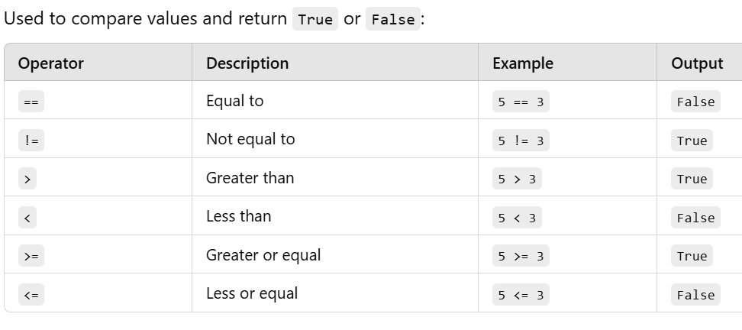
Recall: Operators in Python [Relational Operators]

Slide 4
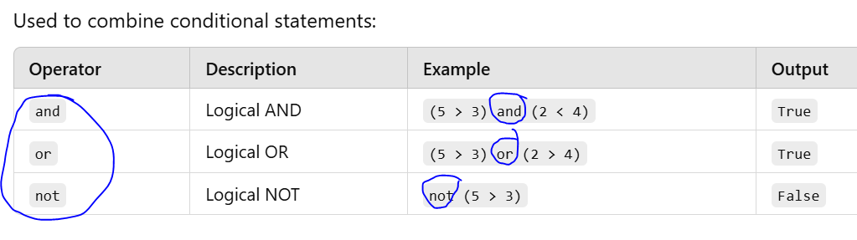
Recall: Operators in Python [Logical Operators]

Slide 5
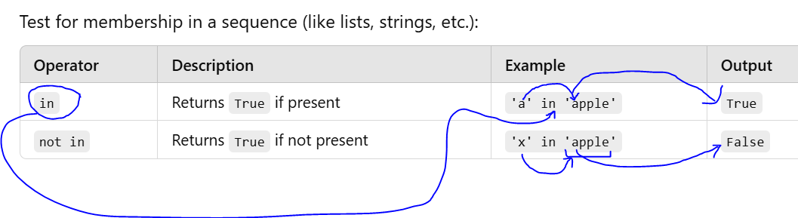
Recall: Operators in Python [Membership Operators]

Slide 6
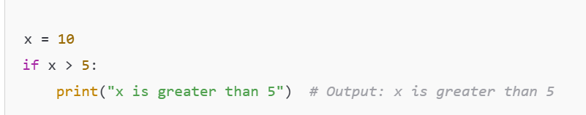
Recall: Conditional Statements

Slide 7
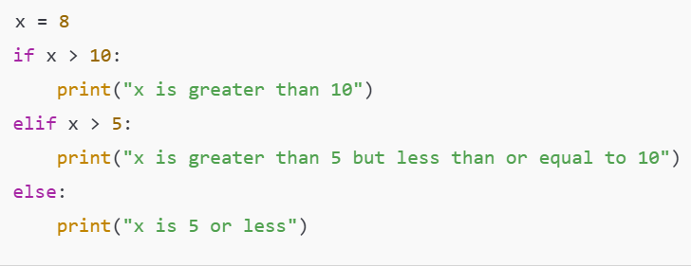
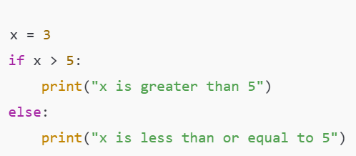
Recall: Conditional Statements

Slide 8
Recall: Function
In Python, a function is a block of code that only runs when it is called.
Functions allow you to organize your code into reusable pieces

Slide 9
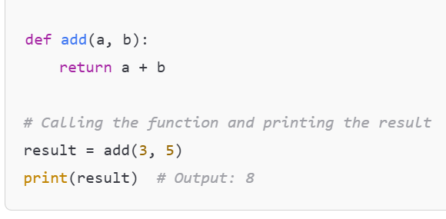
Recall: Function

Slide 10
Recall: Recursion
Recursion is the process in which a function calls itself directly or indirectly to solve a problem.

Slide 11
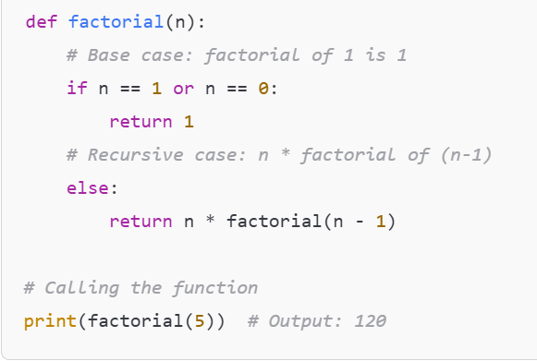
Recall: Recursion

Slide 12
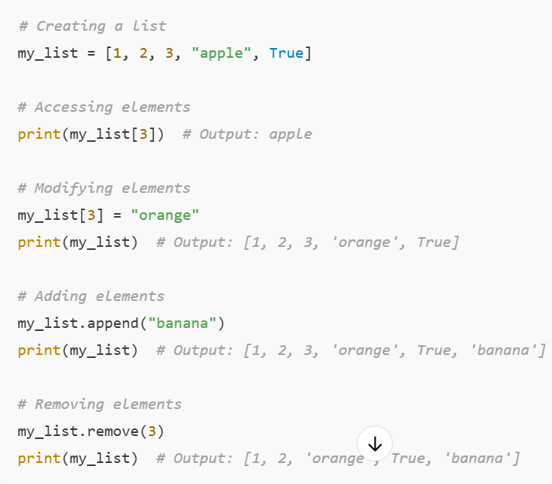
Recall: List
A list is a mutable, ordered collection of items.
You can add, remove, or change elements.

Slide 13
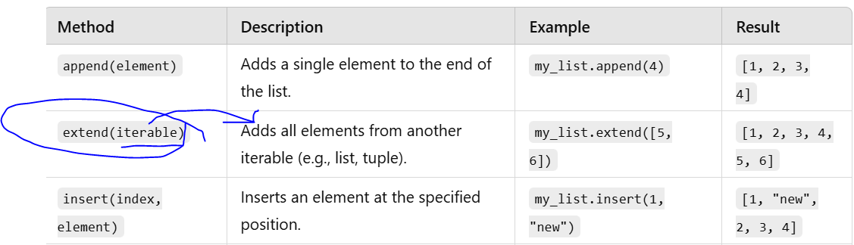
Recall: List

Slide 14
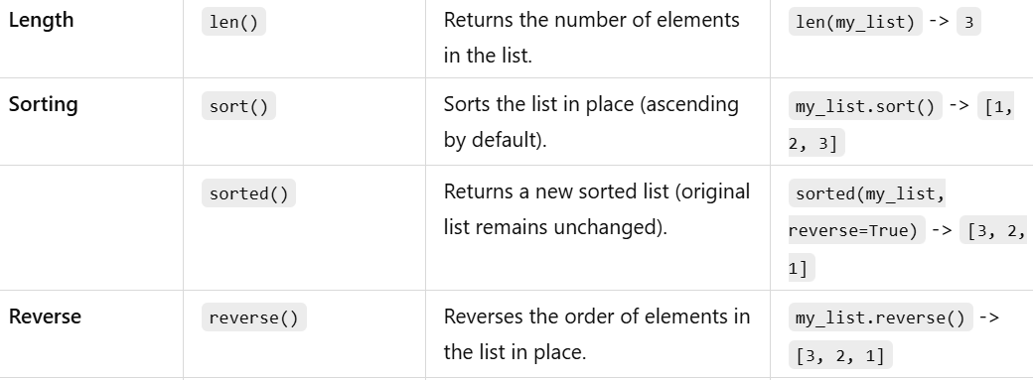
Recall: List

Slide 15
Homework???
List Slicing

Slide 16
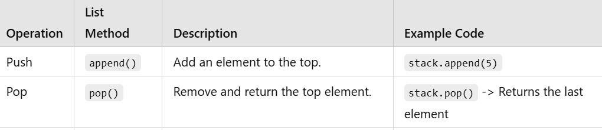
Recall: Stack through List

Slide 17
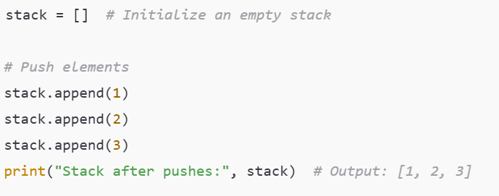
Recall: Stack through List

Slide 18
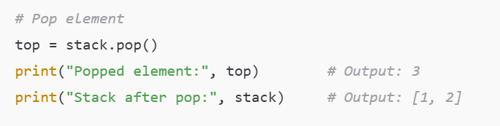
Recall: Stack through List

Slide 19
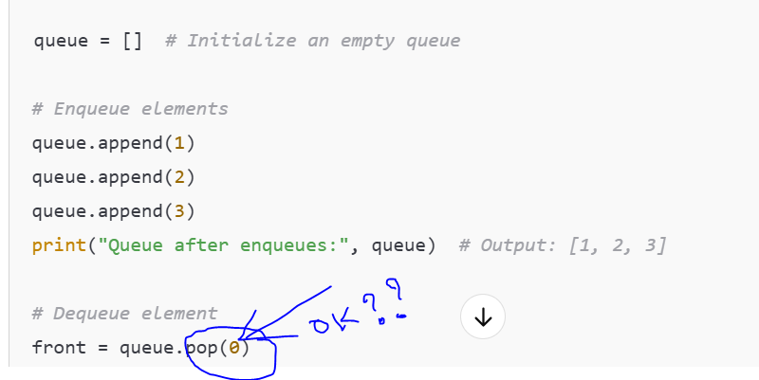
Recall: Queue through List

Slide 20
Is pointer available in Python???

Slide 21
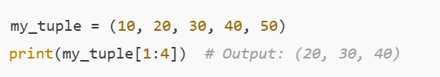
Tuple
A tuple is an immutable, ordered collection of elements in Python.

Slide 22
Dictionary
A dictionary in Python is an unordered collection of data in the form of key-value pairs.
Each key must be unique, and values can be of any data type, including other dictionaries, lists, or tuples.

Slide 23
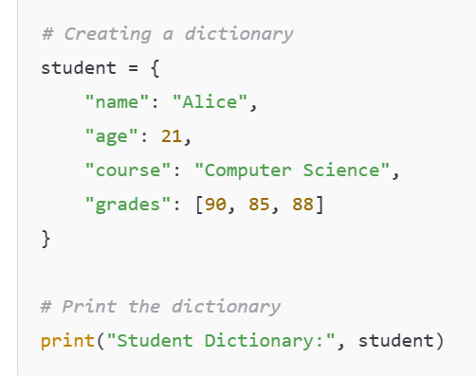
Dictionary

Slide 24
Graph Representation
How can you represent a graph through List and Tuple and Dictionary???

Slide 25
Advanced Libraries in Python used in AI(ML and Deep Learning)

Slide 26
NumPy
NumPy is one of the most powerful libraries in Python for numerical computations.
It provides support for arrays, matrices, and a large collection of mathematical functions to operate on these data structures.

Slide 27
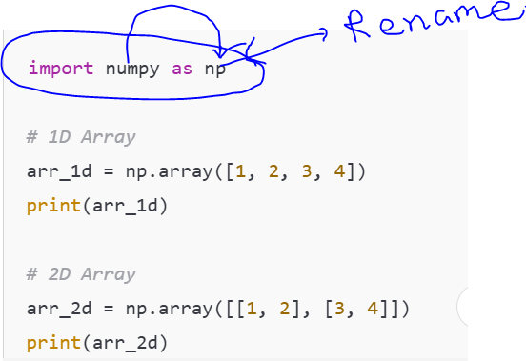
NumPy [nd-array]

Slide 28
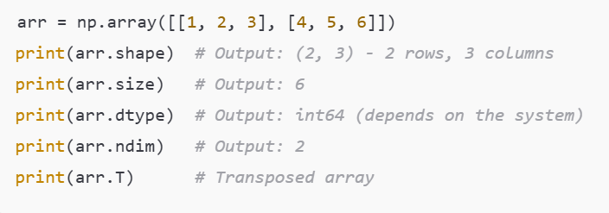
NumPy [nd-array attributes]

Slide 29
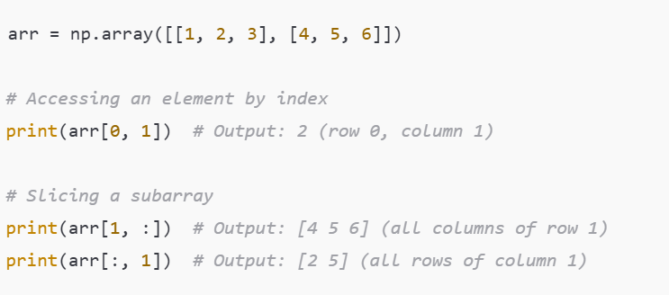
NumPy [array slicing]

Slide 30
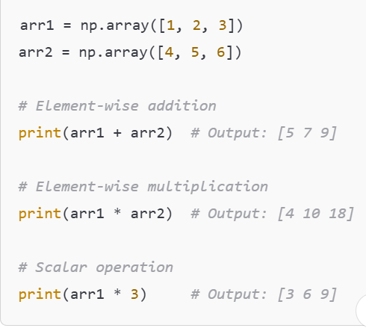
NumPy [Operation on array]

Slide 31
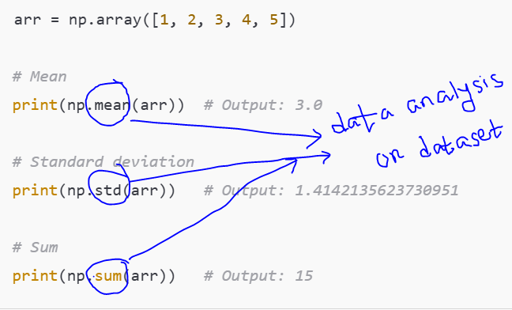
NumPy [Operation on array]

Slide 32
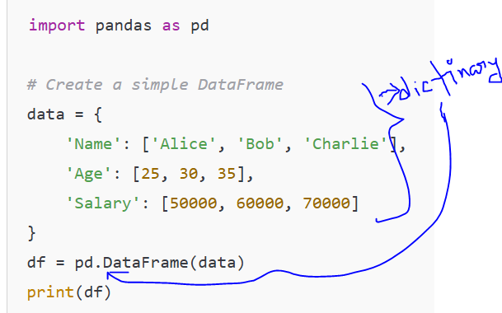
Pandas in Python
Used for data manipulation and analysis.
Dataframe: A 2-dimensional labeled data structure that resembles a table or a spreadsheet.

Slide 33
Data Visualization
Data visualization is the process of representing data graphically to better understand patterns, trends, and insights.
In Python, libraries like Matplotlib, Seaborn, Plotly, and Pandas are commonly used for data visualization.

Slide 34
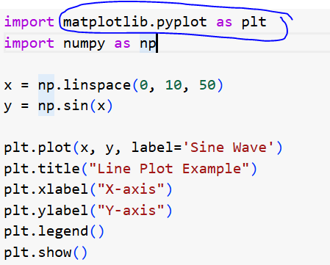
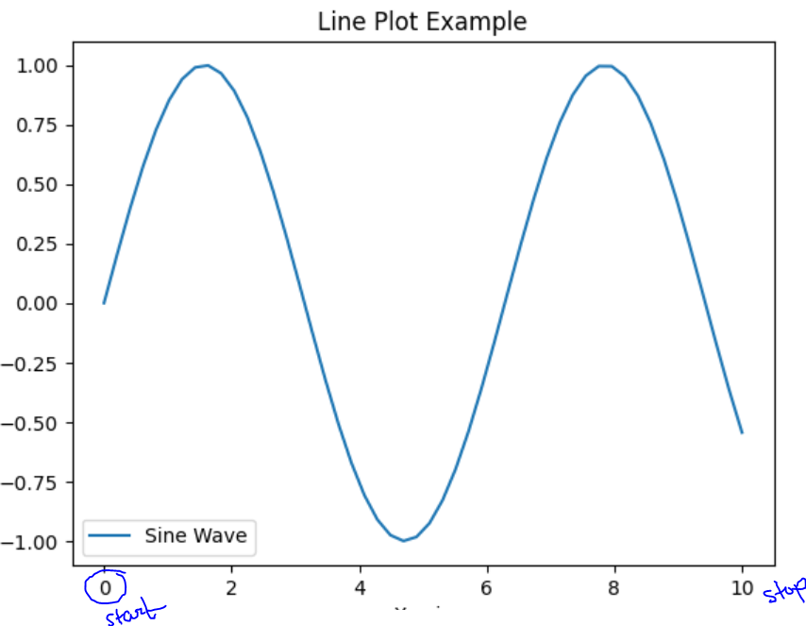
Line plot

Slide 35
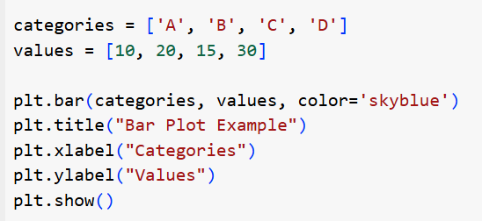
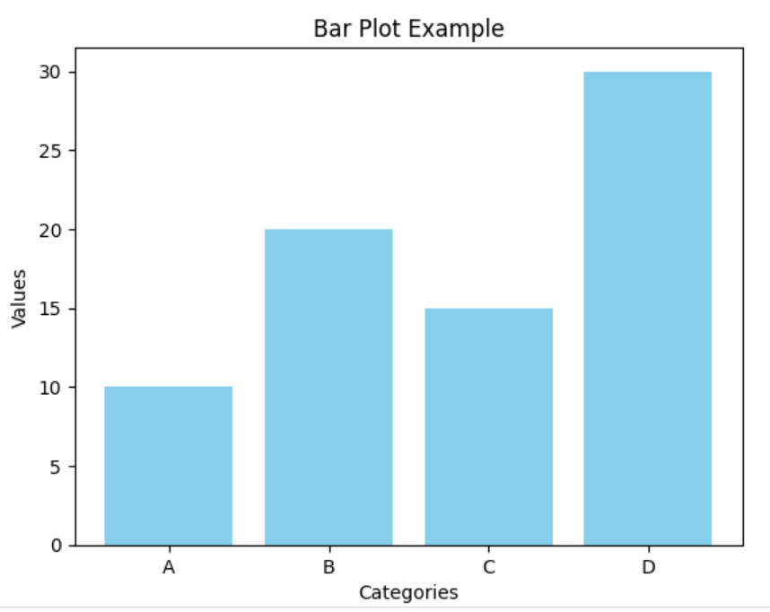
Bar plot

Slide 36
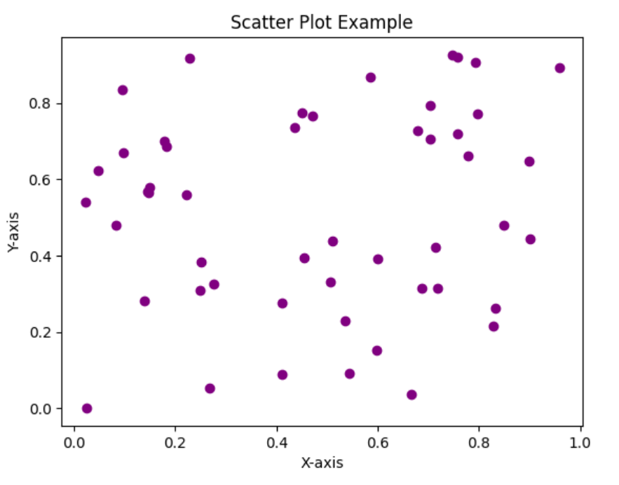
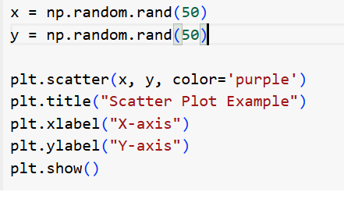
Scatter plot

Slide 37
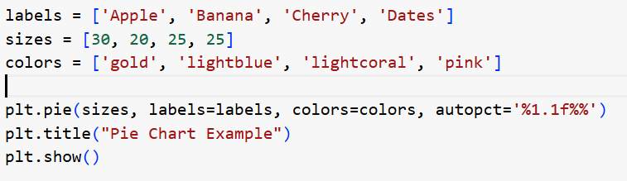
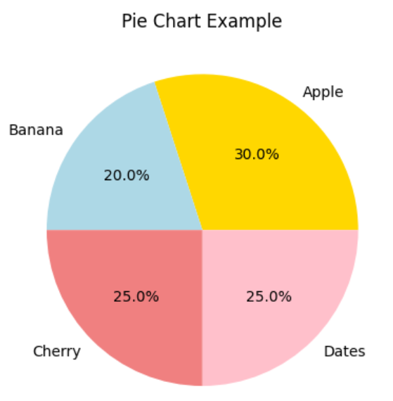
Pie Plot

Slide 38
Data Visualization
Note: Heatmap plot, Correlation analysis will be discussed later.[In Machine Learning and Deep learning]

Slide 39
Next Lab
Play with BFS and DFS

